Slide 1

W A S H I N G T O N S T A T E U N I V E R S I T Y
Link sign prediction in the undirected graph
Presentation to Course CPT_S_591
Tengyang Zhang, Rusu Wu, Yi Yao
School of Electrical Engineering & Computer Science
APRIL 26, 2022

Slide 2





Link sign prediction in the undirected graph | APRIL 2022
Notes:
A Primer on Link Sign Prediction

Slide 3


Link sign prediction in the undirected graph | APRIL 2022
11
9
10
1
6
3
2
4
5
8
7
Notes:
Strategy to Solve a Link Sign Prediction Problem

Slide 4



Link sign prediction in the undirected graph | APRIL 2022
11
9
10
1
6
3
2
4
5
8
7
Notes:
Strategy to Solve a Link Sign Prediction Problem

Slide 5
Link sign prediction in the undirected graph | APRIL 2022
11
9
10
1
6
3
2
4
5
8
7
Notes:
Strategy to Solve a Link Sign Prediction Problem

Slide 6
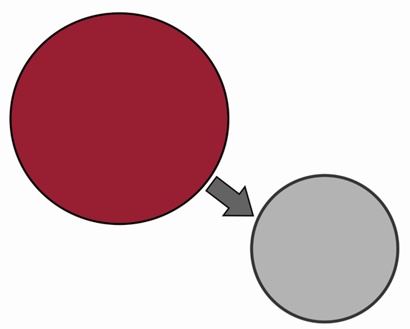
Link sign prediction in the undirected graph | APRIL 2022
Features:
the shortest path
node’s degree with sign
clustering coefficient
Centrality
Machine Learning

Slide 7
Link sign prediction in the undirected graph | APRIL 2022
Program display

Slide 8
QUESTIONS?
Thank you and GO COUGS!!
Yi Yao
School of EECS
Master of
Computer Engineering
yi.yao@wsu.edu
Tengyang Zhang
School of EECS
Master of
Computer Science
tengyang.zhang@wsu.edu
Rusu Wu
School of EECS
Master of
Computer Engineering
rusu.wu@wsu.edu

Slide 9
Link sign prediction in the undirected graph | APRIL 2022
11
9
10
1
6
3
2
4
5
8
7
Notes:
Strategy to Solve a Link Sign Prediction Problem

Slide 10
Link sign prediction in the undirected graph | APRIL 2022

